Slide 1

CS410 Course Project: Implement LRR for MeTA
By Zachariah Dick

Slide 2
Project Description
Implement the aspect segmentation and Latent Rating Regression model in C++ from the paper “latent aspect rating analysis on review text data: a rating regression approach”.
Developed with the intent to be easily ported into the MeTA codebase.
I was able to use the original Java project code as a reference for this. So, ultimately the project was rewriting the Java code in C++.

Slide 3
Development Environment
OS: Windows 10
Build Tools: MINGW64 implementation of g++.
IDE: Visual Studio Code

Slide 4
In This Repository
The C++ code can be found in the LARA directory.
The original Java code can be found in the OldJavaLARAProject directory.
The project directory structure is the same between the two.
Src: contains the source code files.
Includes: contains header files.
Data: includes the data input and output files used by the project.
The next slide has a picture of the directory tree structure.

Slide 5


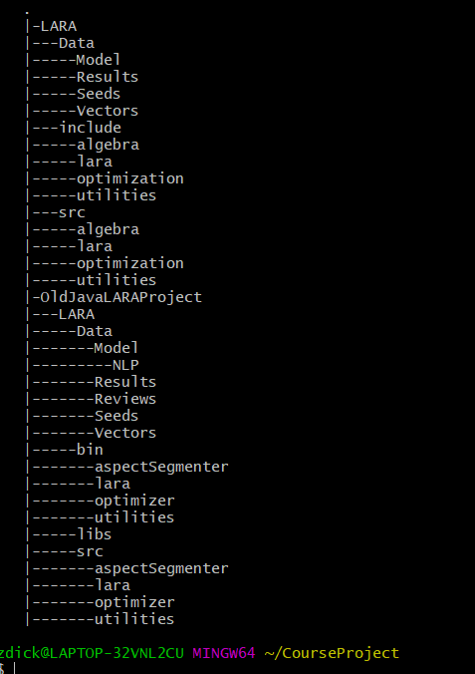




Slide 6
Challenges
The MeTA project had too much technical debt for me to build it locally on my machine without many errors.
The original LARA Java Code project files were not recognizable by my IntelliJ IDE, so I was not able to use it as a debugging tool for my C++ implementation.
The Java code referenced some jar file Java specific libraries that I was not able to replace properly. One was a linear algebra library that I replaced by implementing the functionality.

Slide 7
State of the Project
I can build and run the program, but the results are not recognizable by the “topics.py” script in the data file, which is used to print out the top M topics.
With some investigation it is due to the f value and gnorm values being insanely large as they are going through the “optimizer” code.
Example of the values on next slide displayed in picture of the output from a run of the program (e.g. gnorm printed as “inf”).

Slide 8
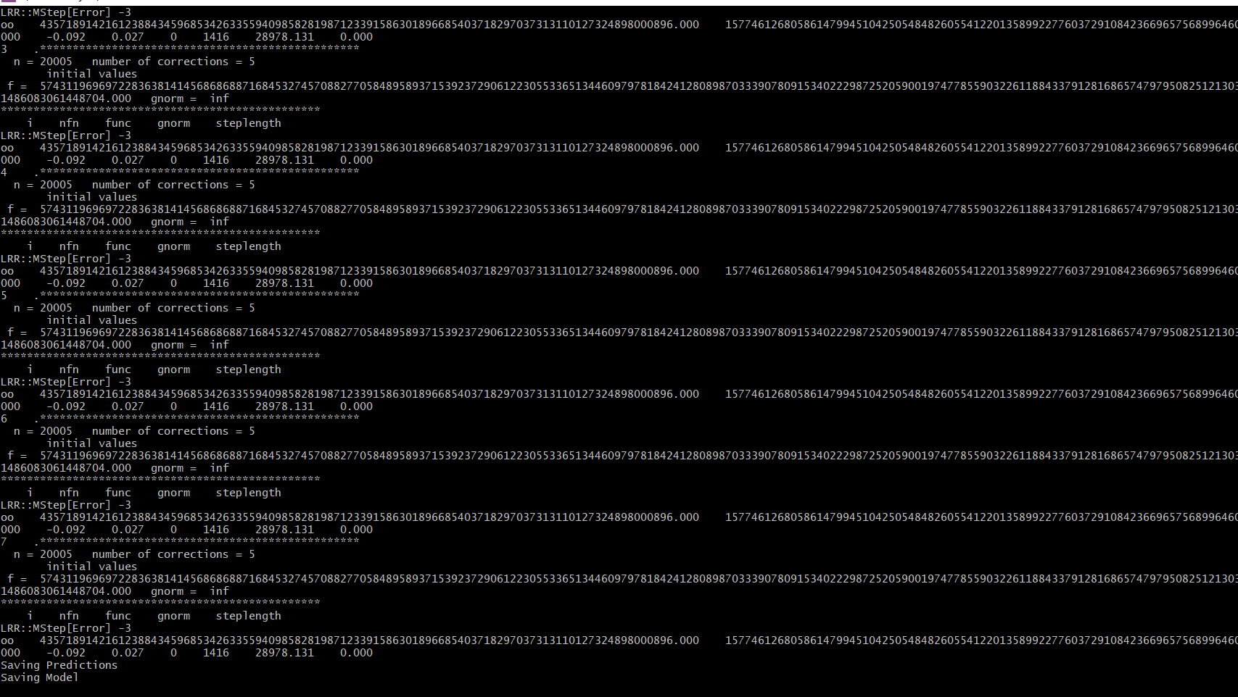


Slide 9
Building the Code
Ensure you have a version of MINGW64 installed with g++.
Open a command prompt and go to the CourseProject/LARA directory and run the command “make all” (or whatever make-like command your version of MINGW64 uses for running makefiles).
The program will build into the executable “prog.exe”.
See next slide for example picture.

Slide 10
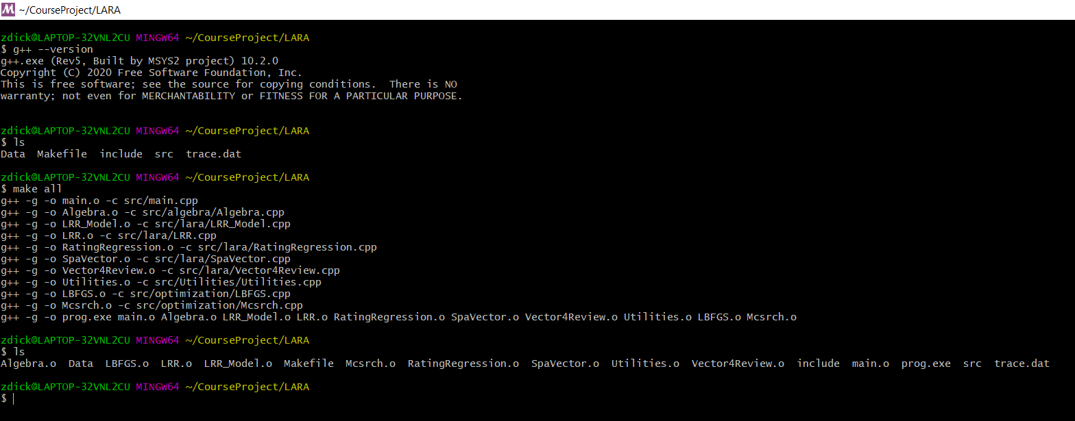


Slide 11
Running the Code
There is a test function in ./LARA/src/main.cpp call lrr_test(), where you can modify the parameters for this function.
You will find a document in this code called “manual.pdf” which comes from the original java project and contains more detail about the Lara implementation in these projects.
Unfortunately running the C++ project does not currently produce any meaningful results.
You can see the saved model, and predictions in the ./LARA/Data directory.
See next slide for example picture.

Slide 12
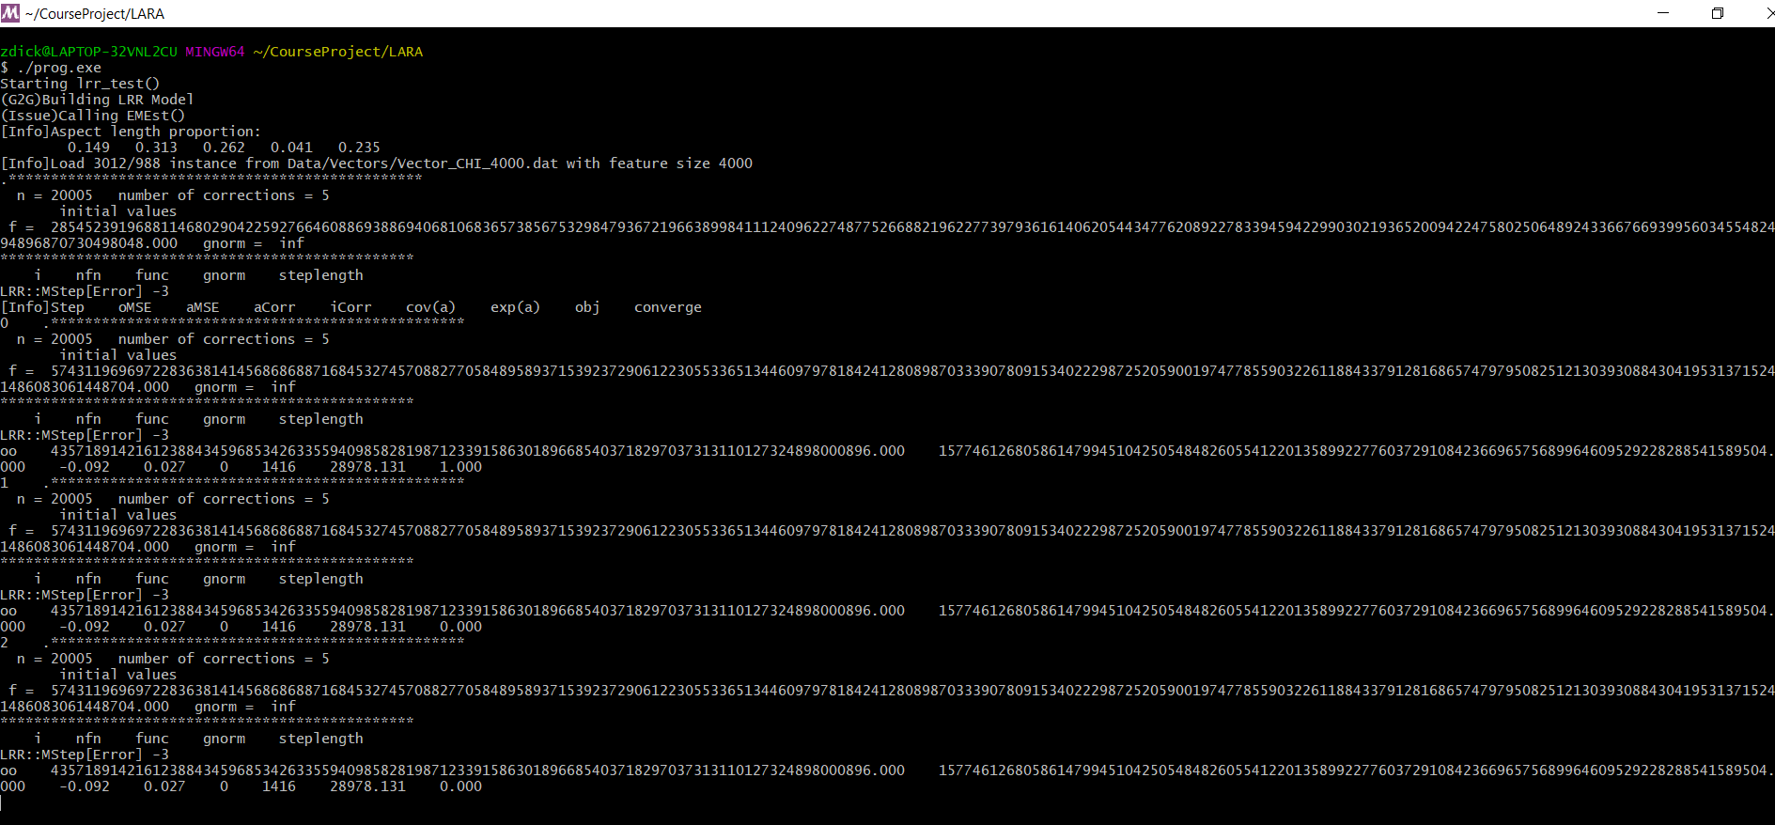


Slide 13
Next Steps (if I had more time!)
Upgrade the Java project so that I can run it as a reference of comparison to the C++ project.
Upgrade the MeTA project so that it can be built with updated tools.
Replace the algebra implementation with an optimized library, maybe a Boost library.
Replace the LBFGS code with an updated optimizer quasi-newton algorithm.
Develop a dataset with expected output for each function using the what has been output by the Java code.

Slide 14
References
Hongning Wang, Yue Lu, and ChengXiang Zhai, Latent aspect rating analysis on review text data: a rating regression approach. In Proceedings of ACM KDD 2010, pp. 783-792, 2010. DOI=10.1145/1835804.1835903

